Slide 1
Lecture 10
Blueprints in Action 1

Slide 2
Lecture Goals and Outcomes
The goals of this lecture are to
Present transforms
Explain world coordinates
Demonstrate the difference between relative and world-based transforms
Show how to use vector operations
Show some vector functions
By the end of this lecture you will be able to
Use vectors to represent location and movement
Distinguish between world and local coordinates
Use vector operations and functions

Slide 3

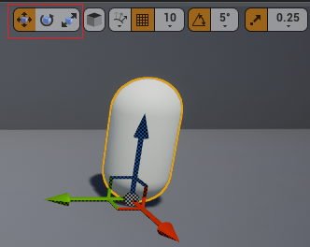
Transform
Every Actor has three Transform properties that represent its world location, rotation, and scale, as shown in the top image on the right.
You can modify the Actor’s transforms using the Details panel or by using gizmos in the Level Editor.
In the Level Editor, there are buttons to select the type of transformation to apply to an Actor. The bottom image on the right shows those buttons highlighted in red.

Slide 4
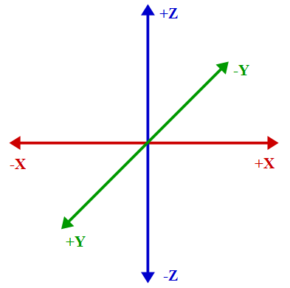
World coordinates
3D space is represented by three axes: X, Y, and Z.
There are different ways to organize these axes. Unreal Engine uses the approach displayed in the figure on the right.
Any position in 3D space can be represented using a set of values for X, Y, and Z indicating the position on each axis. These values are stored in the Location variable, which is part of the transform struct, and they determine what is known as world location.

Slide 5
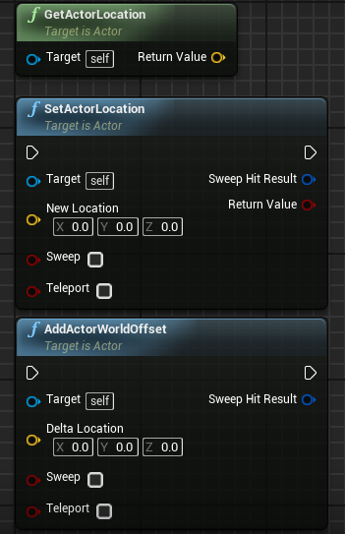
Location functions
By default, an Unreal unit (uu) equals 1 centimeter. To use the values of the Location variable in a Blueprint, the following functions can be used:
GetActorLocation: Returns the current position of the Actor.
SetActorLocation: Sets a new position for the Actor.
AddActorWorldOffset: Uses the values of the Delta Location parameter to modify the current position of the Actor.

Slide 6
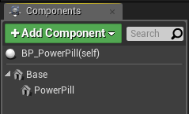
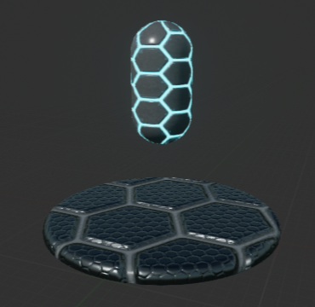
Relative Transform
There is another concept known as relative transform.
To understand this concept, take as an example a Blueprint with two components, a Base component, which is the root component, and a PowerPill component, as seen in the image on the right.
The Location values of the PowerPill component are X = “0”, Y = “0”, Z = “70”.
The position of the PowerPill component is relative to that of the root component, so when the Base component is moved, the PowerPill component will follow the root component’s movement, as it must always be located at a distance from the Base component of 70 cm on the Z axis.

Slide 7
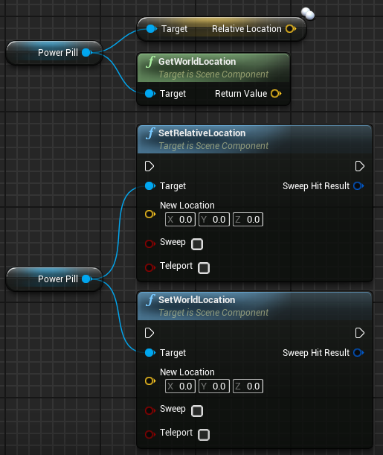
Relative Transform functions
The position of the PowerPill component can be obtained in two ways: its relative location, which in this example is (0, 0, 70); or its world location, which in this case is the world position of the parent component (the Base component) plus the relative position of the PowerPill component.
The position of the component can also be defined in two ways using the functions SetRelativeLocation and SetWorldLocation. The SetRelativeLocation function defines a new position of the PowerPill component relative to the position of the root component, and the SetWorldLocation function receives as an input parameter a world coordinate and defines the position of the PowerPill component so that the sum of the position of the Base component and the position of the PowerPill component is equal to the specified world coordinates.

Slide 8
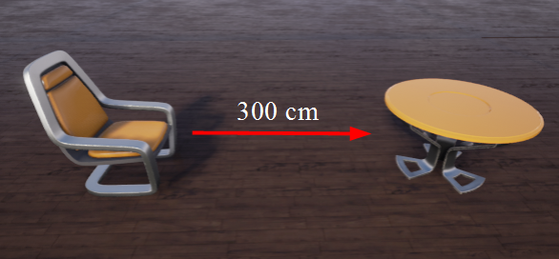
Points and Vectors
A vector is represented in Unreal Engine as a structure that contains the float values X, Y, and Z.
These values can be interpreted in various ways. One way a vector is used is to represent a point (or position) in 3D space. For example, every Actor has a variable called “Location” that returns a vector value.
Vectors are also used to represent movement. In the example on the right, in order to guide a robot to go from the chair to the table, two pieces of information are needed: the direction in which the robot should move and the distance.
Both the direction and the distance can be gathered into the vector: “300, 0, 0”.

Slide 9
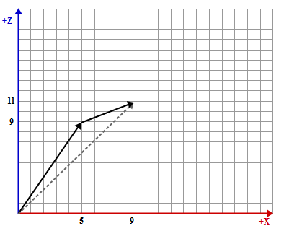
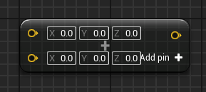
Vector addition
The sum of two vectors is determined by adding each of its elements.
An example:
V1 = (5, 0, 9) and V2 = (4, 0, 2)
V1 + V2 = (5 + 4, 0 + 0, 9 + 2)
V1 + V2 = (9, 0, 11)
The bottom image on the right shows the Blueprint operator for the sum of vectors.

Slide 10
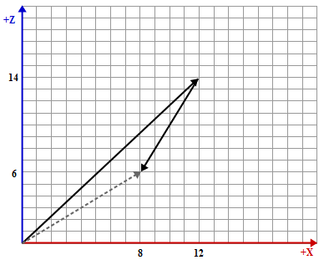
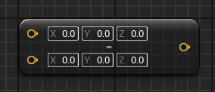
Vector Subtraction
The subtraction of one vector from another is determined by subtracting each of its elements.
An example:
V1 = (12, 0, 14) and V2 = (4, 0, 8)
V1 – V2 = (12 – 4, 0 – 0, 14 – 8)
V1 – V2 = (8, 0, 6)
The image on the right shows the Blueprint operator for the subtraction of vectors.

Slide 11
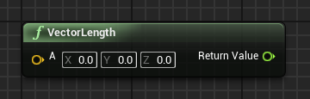
Length of a Vector
The length or magnitude of a vector can be calculated using the Blueprint function seen in the image on the right.
The value can be used to represent the distance between two points.

Slide 12
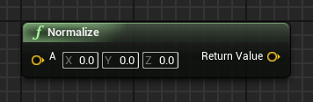
Normalizing Vectors
Vector normalization is used to find a unit vector. The unit vector has a length equal to “1”.
A normalized vector is often used when only the direction needs to be indicated. Some calculations should use only a normalized vector.

Slide 13
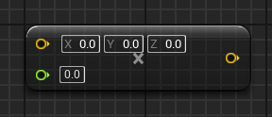
Scalar Vector Multiplication
Multiplication of a vector by a scalar value is done by multiplying each of its elements by the scalar value.
This operation changes the length of the vector.

Slide 14
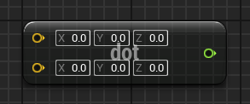
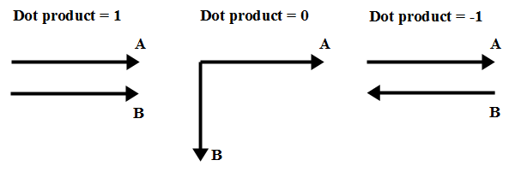
Dot product
A dot product can be used to verify the relationship between two vectors, such as whether they are perpendicular or parallel.
If the two vectors are normalized, the dot product is equal to the cosine of the angle formed between the vectors and can range from –1 to 1.
The image on the right shows some examples of a dot product between two vectors.

Slide 15
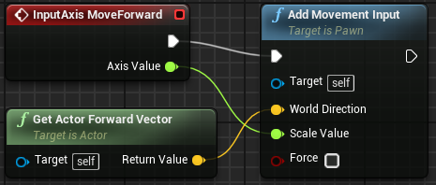
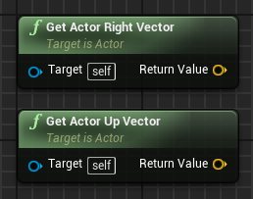
Get Actor Forward Vector
The Get Actor Forward Vector function returns a normalized vector (length = 1) that represents the direction an Actor is pointing in.
In the top image on the right, the InputAxis MoveForward event uses the Get Actor Forward Vector function to move the player forward or backward based on the value of the Axis Value parameter.
For example, using the standard “WASD” keys for movement, pressing the “W” key sets the value of the Axis Value parameter of the InputAxis MoveForward event to “1.0”, while pressing the “S” key sets the value to “–1.0” to reverse the direction.
There are two similar functions that provide vectors representing other directions: the Get Actor Right Vector function and the Get Actor Up Vector function, as seen in the bottom image.

Slide 16
summary
This lecture explained transforms, vectors, and world coordinates.
It also showed how to use vector operations and functions.

